Slide 1

DATABASE
MANAGEMENT SYSTEM

Slide 2


Slide 3

Chehak nayar-1pe15cs042
Divyaksh shukla-1pe15cs051

Slide 4

In our project we aim at
helping the NGO, “Ekk Pahel” by creating a Database management web application to collect and manage its records.
Our goal is to provide a prototype for an end to end web application to manage its donations and finance, record its past and future events and achievements, keep track of its members, their roles and contributions, calendar of events and schedules.
This could help in a smoother and seamless flow in the working process of the NGO, and could help take out the paper and sheet management.

Slide 5
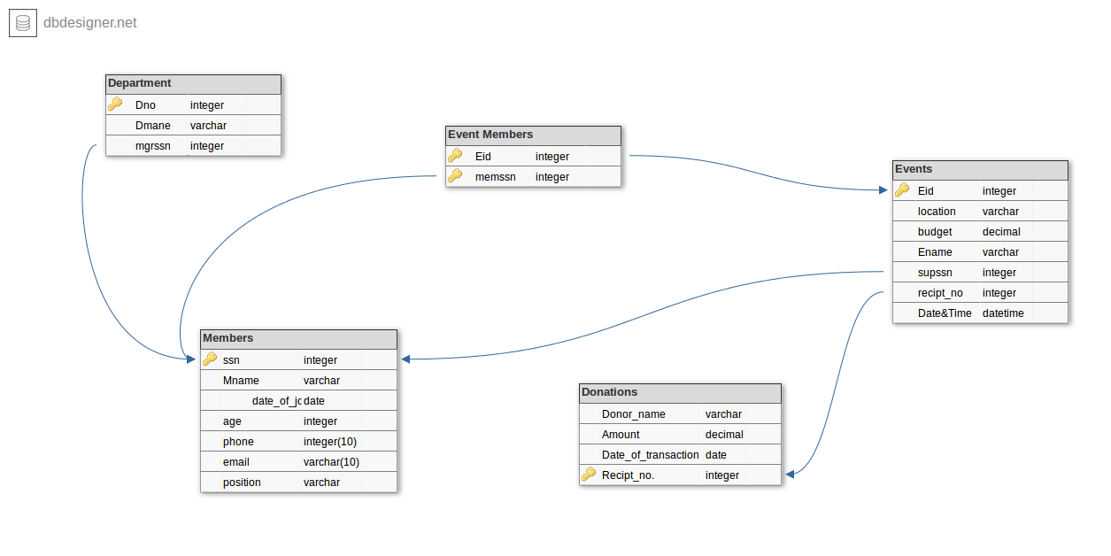
SCHEMA DIAGRAM

Slide 6
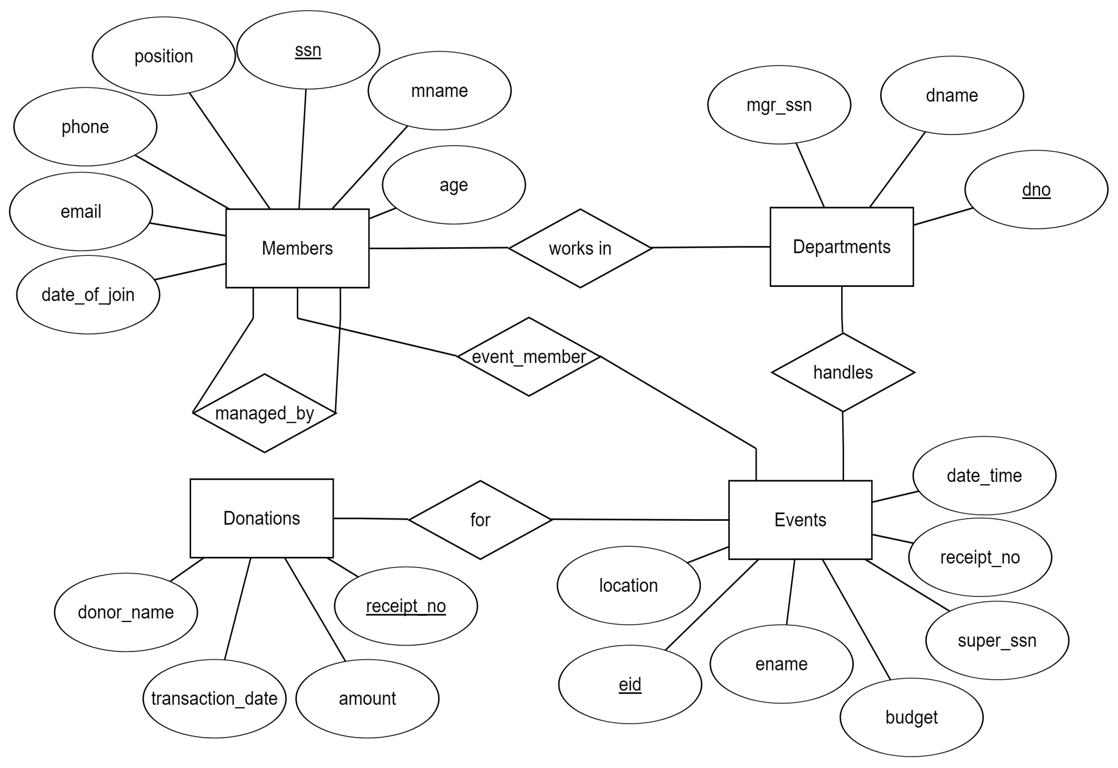
ER DIAGRAM
1
N
N
1
1
1
N
N
N
1

Slide 7

DATABASE
TABLE
DESCRIPTION

Slide 8

DEPARTMENT
mysql> desc Department;
+--------+-------------+------+-----+---------+-------+
| Field | Type | Null | Key | Default | Extra |
+--------+-------------+------+-----+---------+-------+
| dno | int(11) | NO | PRI | NULL | |
| dname | varchar(20) | YES | | NULL | |
| mgrssn | int(11) | YES | MUL | NULL | |
+--------+-------------+------+-----+---------+-------+
3 rows in set (0.01 sec)

Slide 9

MEMBERS
mysql> desc Members;
+--------------+-------------+------+-----+---------+-------+
| Field | Type | Null | Key | Default | Extra |
+--------------+-------------+------+-----+---------+-------+
| ssn | int(11) | NO | PRI | NULL | |
| mname | varchar(20) | YES | | NULL | |
| joining_date | date | YES | | NULL | |
| age | int(11) | YES | | NULL | |
| phone | varchar(10) | YES | | NULL | |
| email | varchar(10) | YES | | NULL | |
| position | varchar(20) | YES | | NULL | |
+--------------+-------------+------+-----+---------+-------+
7 rows in set (0.01 sec)

Slide 10

EVENTS
mysql> desc Events;
+------------+---------------+------+-----+---------+-------+
| Field | Type | Null | Key | Default | Extra |
+------------+---------------+------+-----+---------+-------+
| eid | int(11) | NO | PRI | NULL | |
| location | varchar(20) | YES | | NULL | |
| budget | decimal(10,0) | YES | | NULL | |
| ename | varchar(20) | YES | | NULL | |
| supssn | int(11) | YES | MUL | NULL | |
| reciept_no | int(11) | YES | MUL | NULL | |
| date_time | datetime | YES | | NULL | |
+------------+---------------+------+-----+---------+-------+
7 rows in set (0.01 sec)

Slide 11

EVENT
MEMBERS
mysql> desc Event_Members;
+--------+---------+------+-----+---------+-------+
| Field | Type | Null | Key | Default | Extra |
+--------+---------+------+-----+---------+-------+
| eid | int(11) | NO | PRI | NULL | |
| memssn | int(11) | NO | PRI | NULL | |
+--------+---------+------+-----+---------+-------+
2 rows in set (0.00 sec)

Slide 12

DONATIONS
mysql> desc Donations;
+------------------+---------------+------+-----+---------+------+
| Field | Type | Null | Key | Default | Extra|
+------------------+---------------+------+-----+---------+------+
| donor_name | varchar(20) | YES | | NULL | |
| amount | decimal(10,0) | YES | | NULL | |
| transaction_date | date | YES | | NULL | |
| receipt_no | int(11) | NO | PRI | NULL | |
+------------------+---------------+------+-----+---------+------+
4 rows in set (0.00 sec)

